Slide 1
W10 class 과제
이재현 조윤지 조재현

Slide 2

캐릭터 종류1
//캐릭터 함수
void koko(){
float e;
e =PI;
noStroke();
fill(84, 180, 83);
arc(x-15*d, y-4*d, 30*d, 10*d, e+e/3, 2*e);
arc(x+15*d, y-4*d, 30*d-3*d, 10*d-3*d, e, 2*e-e/3);
stroke(41, 130, 43);
strokeWeight(0.5*d);
bezier(x, y-4*d, x-8*d, y-7*d, x-8*d, y-7*d, x-16*d, y-7.3*d);
bezier(x, y-4*d, x+7*d, y-6*d, x+7*d, y-6*d, x+16*d, y-6.3*d);
noStroke();
fill(196, 238, 140);
arc(x, y+20*d, 40*d, 20*d, 0, e);
arc(x, y+20*d, 40*d, 50*d, e, 3*e/2);
arc(x, y+20*d, 40*d, 50*d, 3*e/2, 2*e);
fill(80, 107, 62);
circle(x-8*d, y+18*d, 5*d);
circle(x+8*d, y+18*d, 5*d);
fill(246, 150, 177);
circle(x+13*d, y+20*d, 10*d/3);
circle(x-13*d, y+20*d, 10*d/3);
arc(x, y+22*d, 10*d/3, 10*d/3, e/8, e-e/8);
stroke(186, 84, 108);
strokeWeight(0.5*d);
line(x, y+22.1*d, x, y+22.5*d);
stroke(80, 107, 62);
strokeWeight(0.8*d);
curve(x, y+41*d/2, x, y+43*d/2, x-5*d/2, y+45*d/2, x-7*d, y+21*d);
curve(x, y+41*d/2, x, y+43*d/2, x+5*d/2, y+45*d/2, x+7*d, y+21*d);
noStroke();
fill(254, 254, 254);
circle(x-7.5*d, y+17*d, 2*d);
circle(x+8.5*d, y+17*d, 2*d);
}
}
class mokoko {
//쓰이는 변수
float x, y, d;
//변수에 값 기입
mokoko(float p, float q, float r) {
x = p;
y = q;
d = r;
}
//초기값
mokoko(){
x = width/2;
y = height/2;
d = 5;
}

Slide 3

캐릭터 종류2
void mung(){
fill(255);
stroke(0);
strokeWeight(d*4/5);
circle(x-d*10,y-d*12,w*4/5); //왼쪽귀
circle(x+d*10,y-d*12,w*4/5); //오른쪽귀
ellipse(x,y,d*30,d*30); //얼굴
//눈
fill(0);
circle(x-d*7,y+d,w/2); //눈바탕 (왼)
circle(x+d*7,y+d,w/2); //눈바탕 (오)
ellipse(x-d*7,y+d,d*9,d*5/2); //행성모양 (왼)
//왼쪽눈
fill(255);
stroke(255);
strokeWeight(0);
ellipse(x-d*7,y,d*2,d*3/2); //안광1
arc(x-d*7,y+d*2,d*5/2,d*3/2,0,PI); //안광2
//오른쪽눈
fill(255);
stroke(255);
strokeWeight(0);
ellipse(x+d*7,y,d*2,d*3/2); //안광1
arc(x+d*7,y+d*2,d*5/2,d*3/2,0,PI); //안광2
//입
stroke(0);
strokeWeight(d*3/5);
line(x-d,y+d*5,x,y+d*4);
line(x+d,y+d*5,x,y+d*4);
}
}
class Yoon{
float x, y, w, d;
Yoon(float p, float q, float t, float r) {
x = p;
y = q;
w = t;
d = r;
}
Yoon(){
x = random(0, width);
y = random(0, height);
w = 30;
d = 3;
}
void Life(){
mung();
}

Slide 4

캐릭터 종류3
void cha(){
fill(0, 160, 214);
quad(x-190 * d / 600, y-380 * d / 600, x-20 * d / 600, y-400 * d / 600, x+50 * d / 600, y-200 * d / 600, x-200 * d / 600, y-200 * d / 600);
fill(255);
circle(x, y+500 * d / 600, 1000 * d / 600);
circle(x, y, d);
fill(0);
quad(x-100 * d / 600, y+140 * d / 600, x+100 * d / 600, y+130 * d / 600, x+110 * d / 600, y+180 * d / 600, x-100 * d / 600, y+180 * d / 600);
circle(x-100 * d / 600, y-90 * d / 600, 90 * d / 600);
triangle(x+80 * d / 600, y-100 * d / 600, x+200 * d / 600, y-110 * d / 600, x+130 * d / 600, y-30 * d / 600);
quad(x-200 * d / 600, y-210 * d / 600, x-10 * d / 600, y-160 * d / 600, x-20 * d / 600, y-110 * d / 600, x-240 * d / 600, y-150 * d / 600);
quad(x+220 * d / 600, y-180 * d / 600, x+40 * d / 600, y-160 * d / 600, x+50 * d / 600, y-110 * d / 600, x+240 * d / 600, y-130 * d / 600);
}
}
class snowman{
float x, y, d;
snowman(float a, float b, float c){
x = a; y= b; d= c;
}
snowman(){
x = 400;
y = 300;
d = 100;
}

Slide 5
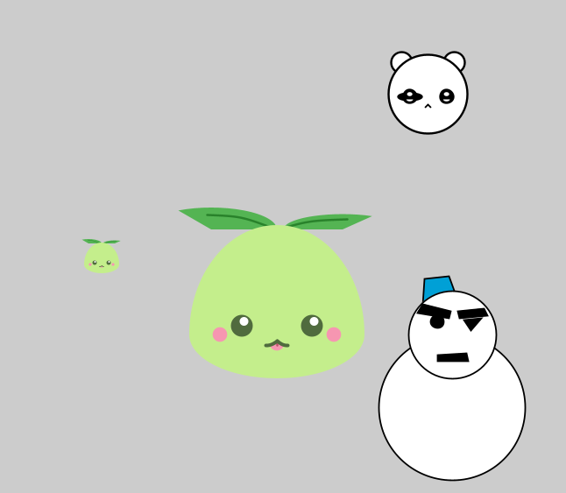
메인 setup
mokoko x,y;
Yoon x1;
snowman x2;
void setup(){
size (800,600);
x = new mokoko(200,300,1);
y = new mokoko();
x1 = new Yoon();
x2 = new snowman(600, 400, 100);
x.koko();
y.koko();
x1.Life();
x2.cha();
}

